Slide 1
Project 3
By Alex Lu
July 2019

Slide 2
Background + Data + Problem
Background: Company X had created an app with energy report dashboard, energy breakdown etc for the domestic utility industry. Utility company Y had given the app a trial among its customer base for a duration of 9 months. The app has 10 screens: Activate, Breakdown, Challenge, Energy_History, Energy_Reports, Feed, Forgot_password, Other, Settings, Trend.
Problem: We would like to find out if The dataset is an app usage time from
Data: Each month there are different cohort of customer signed up for the app. We have a monthly app usage time by screens for each consumerID. (ie. consumer A accessed and stayed on 'Activation' screen for 3seconds, 'Energy Report' screen for 1minute etc.) There are 5286 uniqe customer ID * 10 columns screen usage time for each month (for 9 months) in the raw data. Albeit the users started using the app at different starting month.

Slide 3
Step 1: Clean + Create model dataset
Clean: set ID as index column, drop blanks, column naming convention
Create model dataset:
1. Define active/inactive flag: if an user accessed any screen more than 3 seconds on given any month (other than Setting, forgetting passwords or activation page)
2. Create Monthly dataset: Combine Month T screen usage breakdown data (10 columns) with Month T+1 active/inactive flag.
3. Create combined dataset: merge all 9 month data, and get rid of outliers

Slide 4
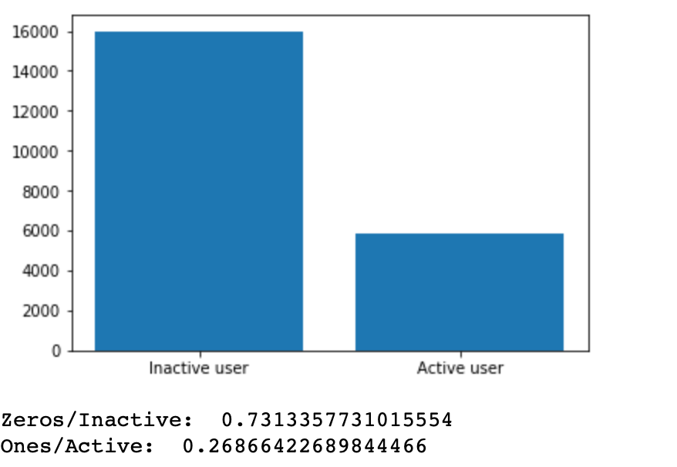
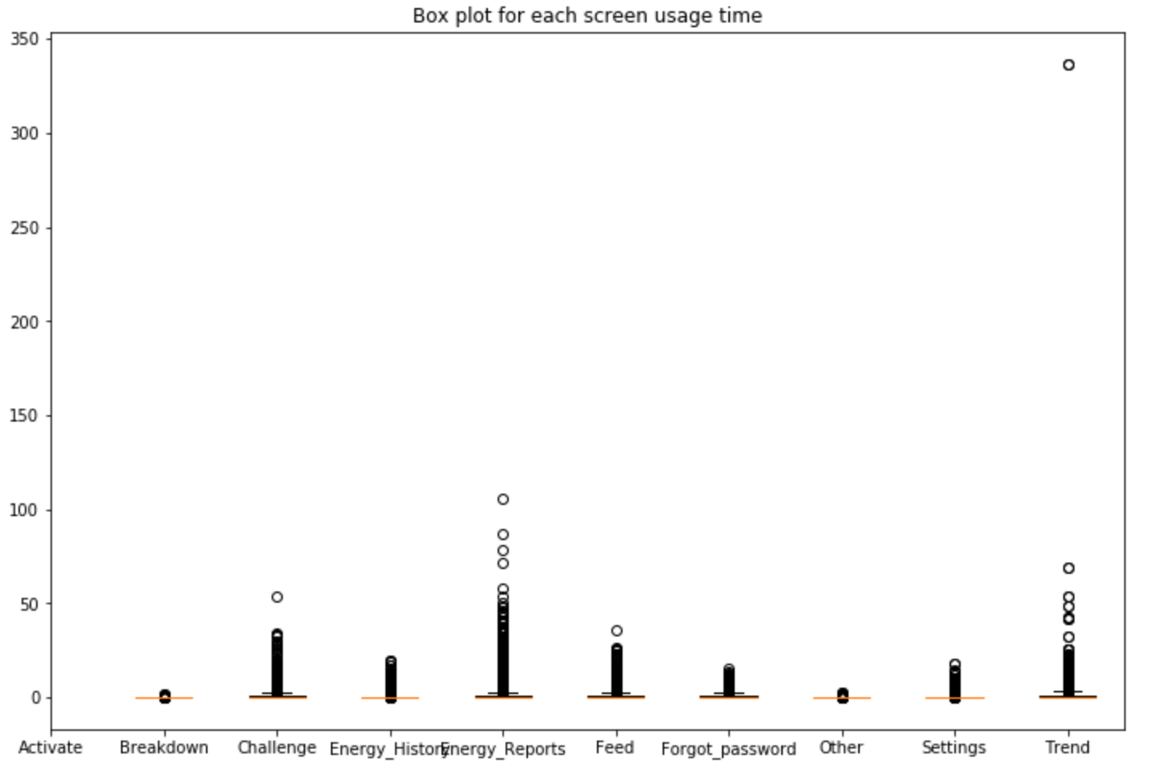
Step 2: Understanding Dataset
The most valuable screen for this app is Energy Reports and Trend. The company should not be spending time on refining breakdown page.
Inbalanced dataset: Inactive 73% vs Active 27%

Slide 5
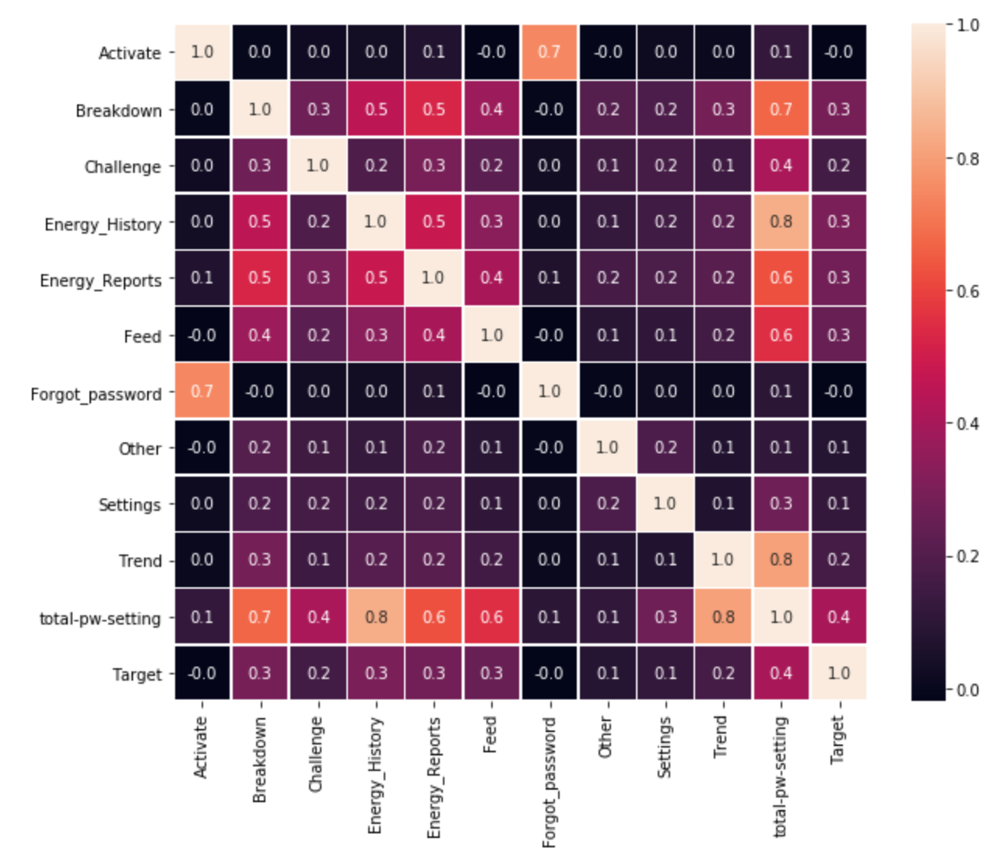
Step 3: Training + Test dataset
For training set: selecting equal number of Inactive vs Active
Examine independence of the variables: couple high correlating points, otherwise, independent

Slide 6

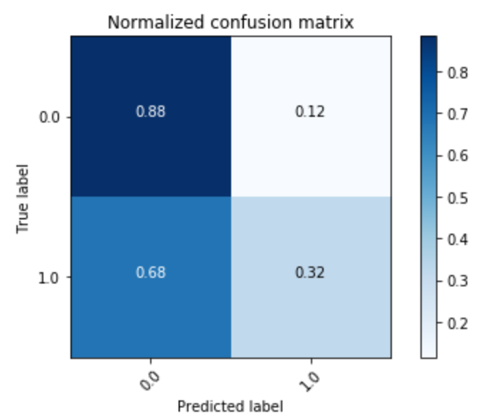
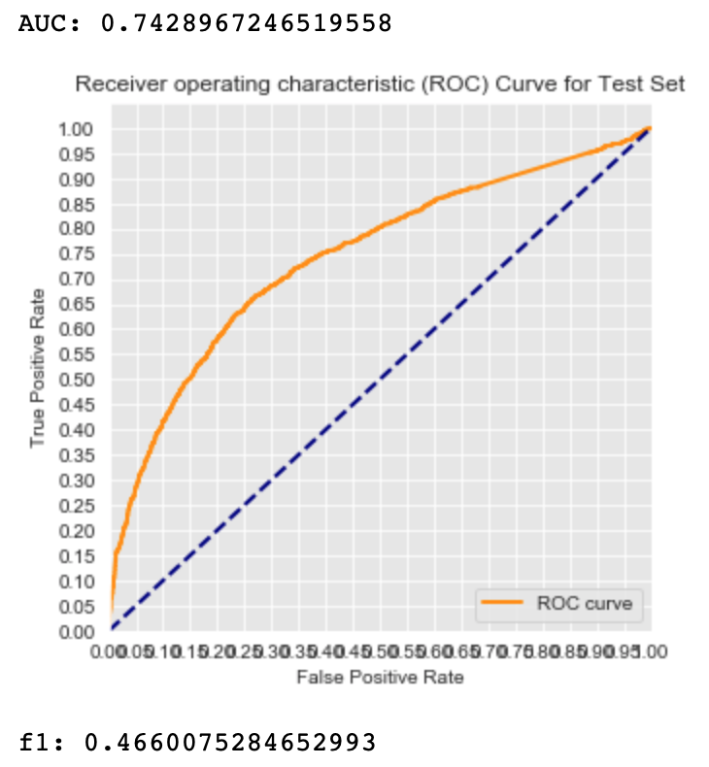
Step 4: Modeling: Logistic Regression
Logistic Regression: F1 Score = 0.47
Confusion Matrix suggested that the model is very good at predicting True Negative cases when an user becomes inactive.

Slide 7
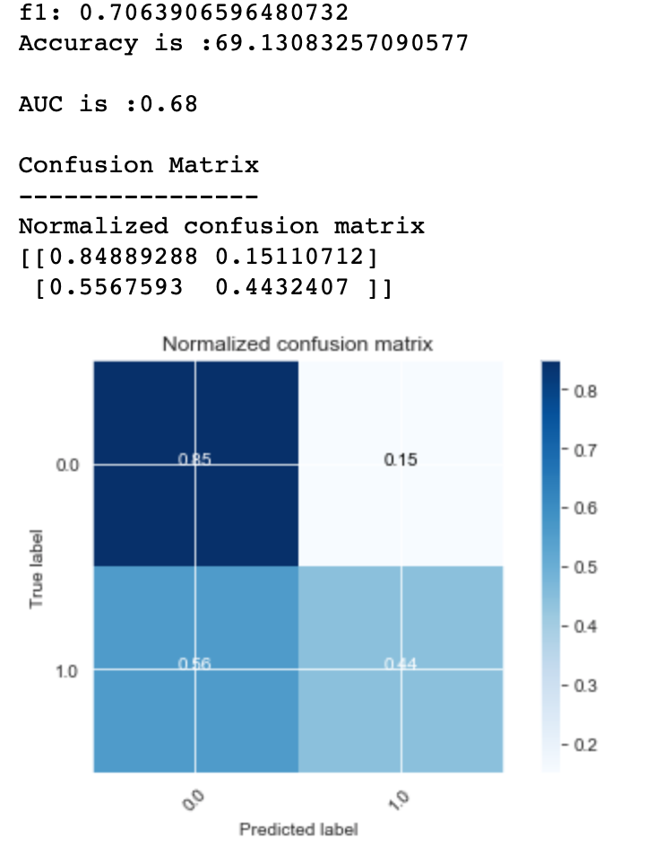
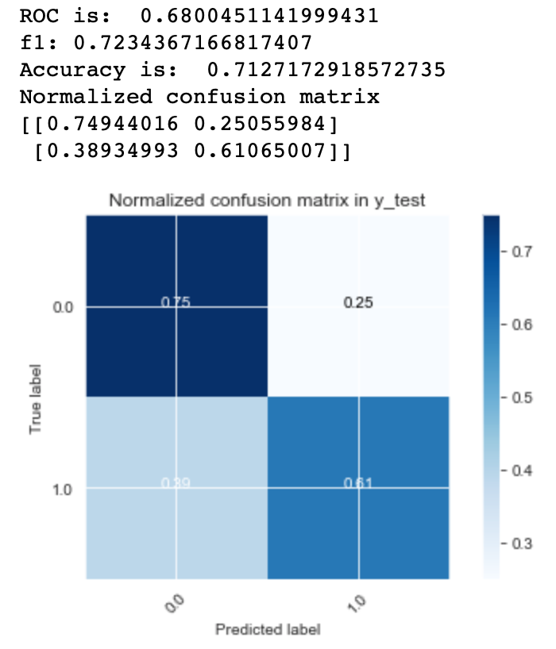
Step 4: Modeling: Decision Tree
Default Model
Optimized Parameters

Slide 8
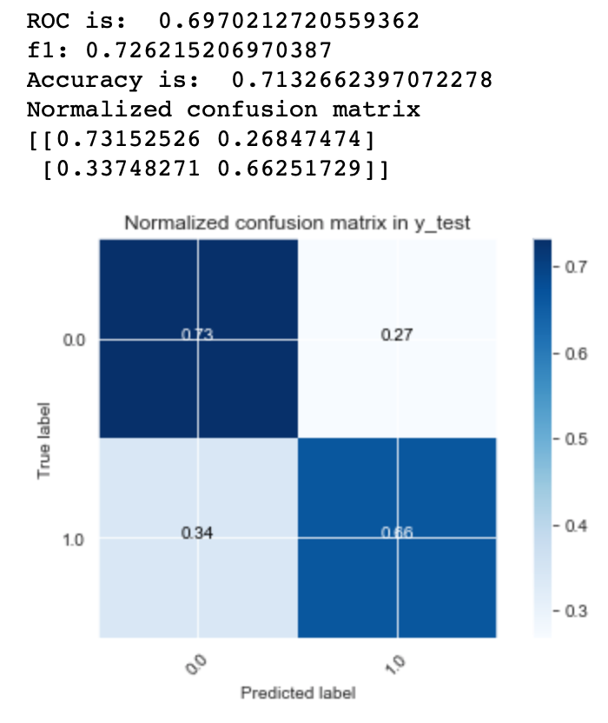
Step 4: Modeling: Random Forest

Slide 9
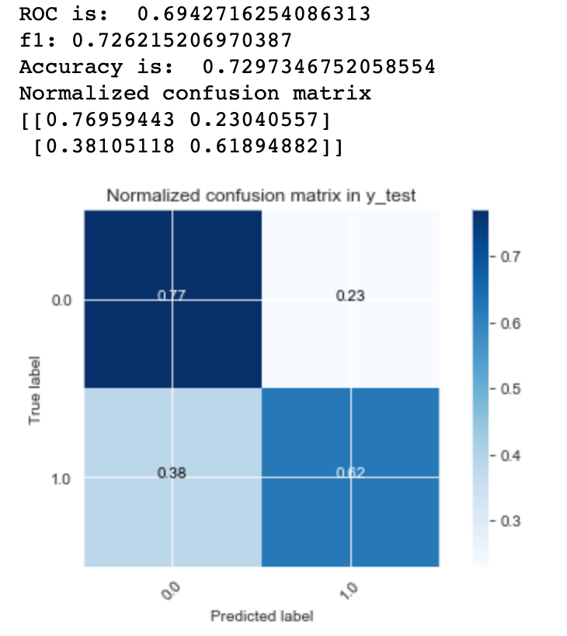
Step 4: Modeling: Adaboosting

Slide 10
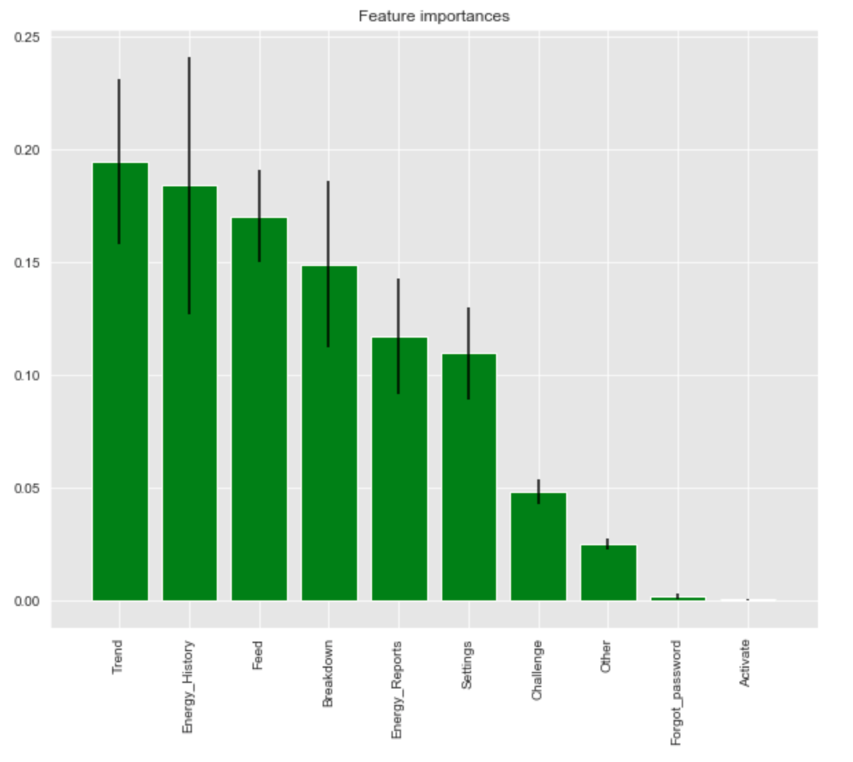
Summary of Modeling Result
In Summary, Random Forest produced the best f1 Score and AUC, albeit the difference between Decision Tree, Random Forest and Ada Boosting are negligible.
Looking at the feature importance on Random Forest Model, we can see that the top 4 feature screens of the app explains more than 50% of the outcome. Ie. If an user access the app in the trend, Energy History, feed and breakdown pages in the previous month, it is very likely that the user will stay active in the current month.
 | Logistic Regression | Decision Tree | DT (optimized) | Random Forest | Ada Boosting
f1 Score | 0.47 | 0.71 | 0.72 | 0.73 | 0.73
AUC | 0.74 | 0.68 | 0.68 | 0.7 | 0.69

Slide 11
Business Implication

